Slide 1
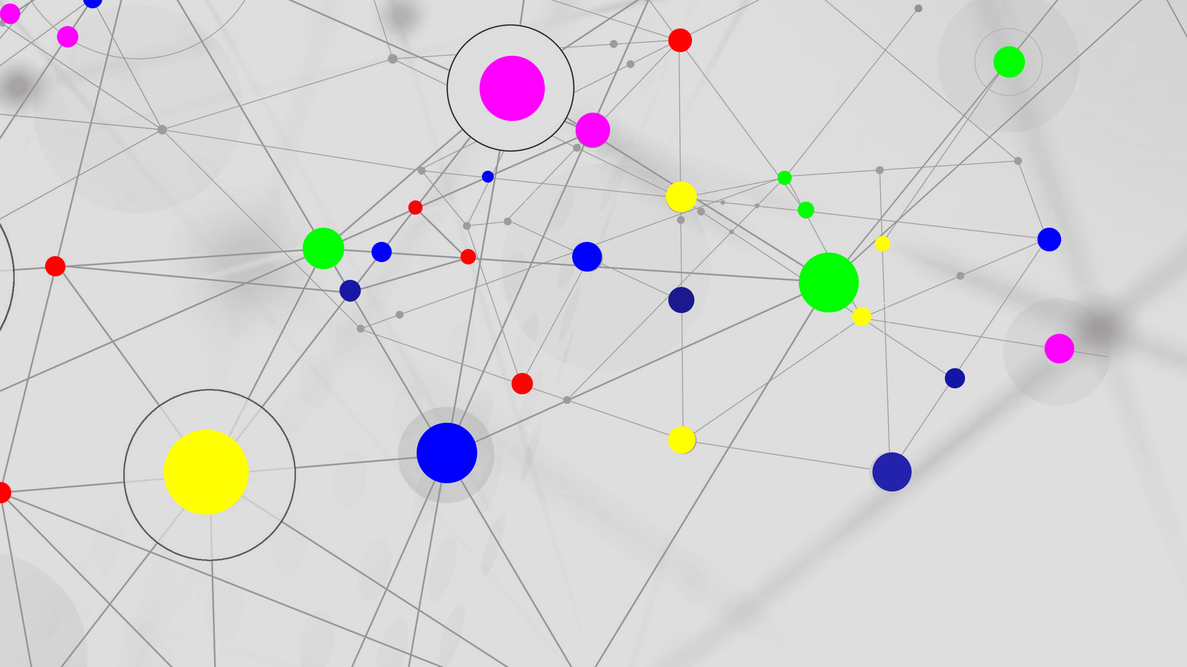
ONE STORE
BE A BRANDED PERSON

Slide 2
ABOUT
The main purpose of this software is to make the employees' work more
efficient, increase employee productivity and decrease manpower.
This software is a very user-friendly one which makes it easier for
the user when using it.
All the data entered are stored in a database , and also the finger
print option ensures the security of the software more.

Slide 3
Criteria
Manage Sell Items
Fringerprint
Admin Home
Reports
Manage Employee
Store Social Media
Splash Screen from
Login
Store Light Coloue&ApplicationColour
Sell Item
Seller Home
Register Loyalty Card
User name & Password
View Item
Reports
Music Player

Slide 4
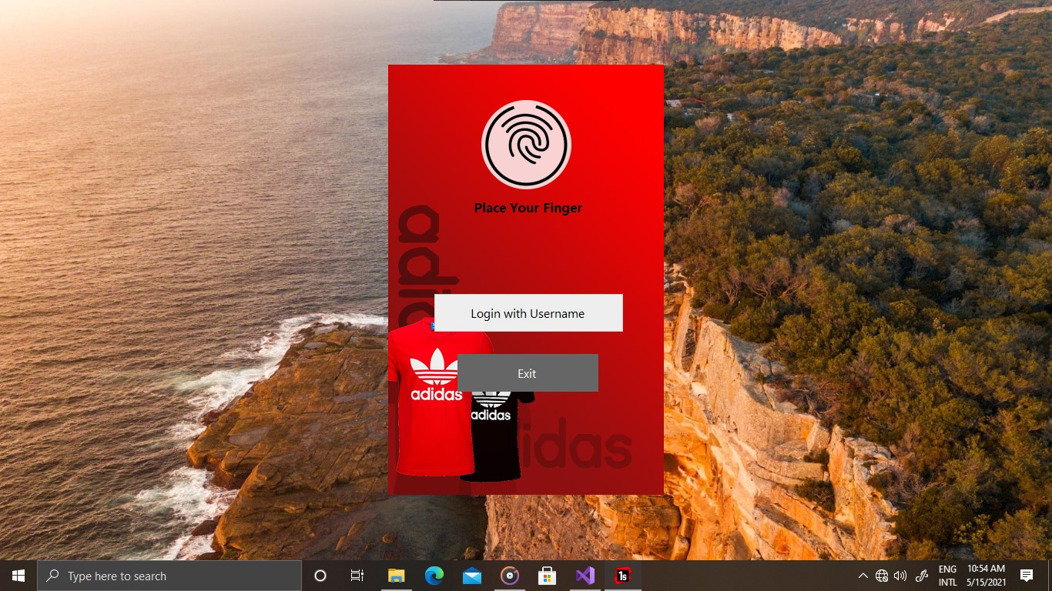
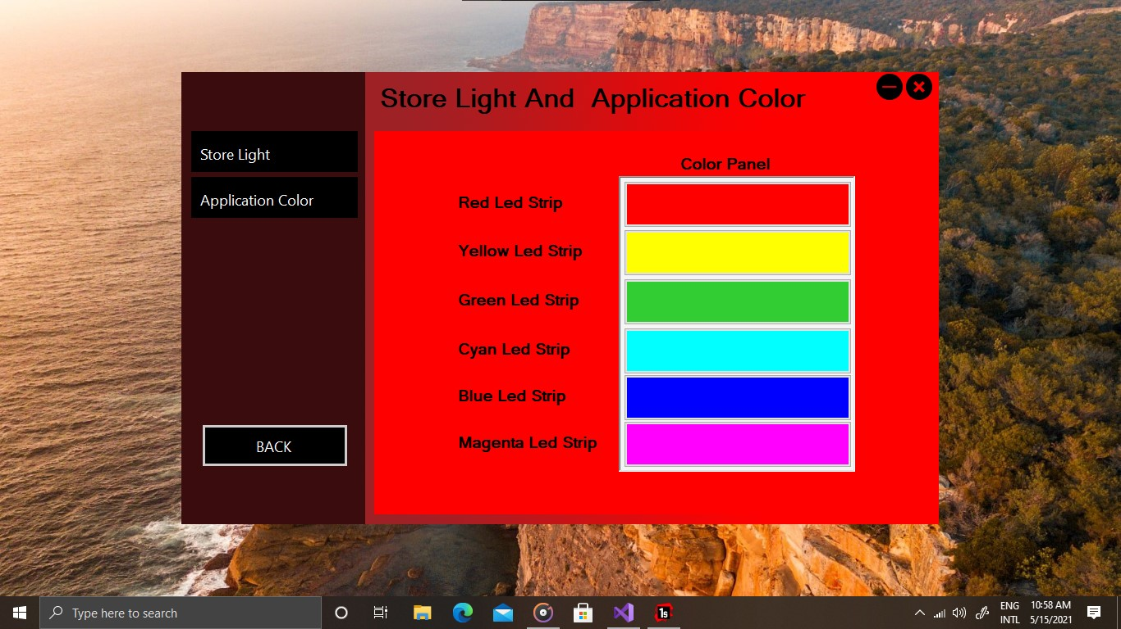
NEW TECHNOLOGIES USED
Here we added a Fingerprint Scanner. Also we used a Colour Pixel LED Strip Control to change showroom’s Colours.

Slide 5
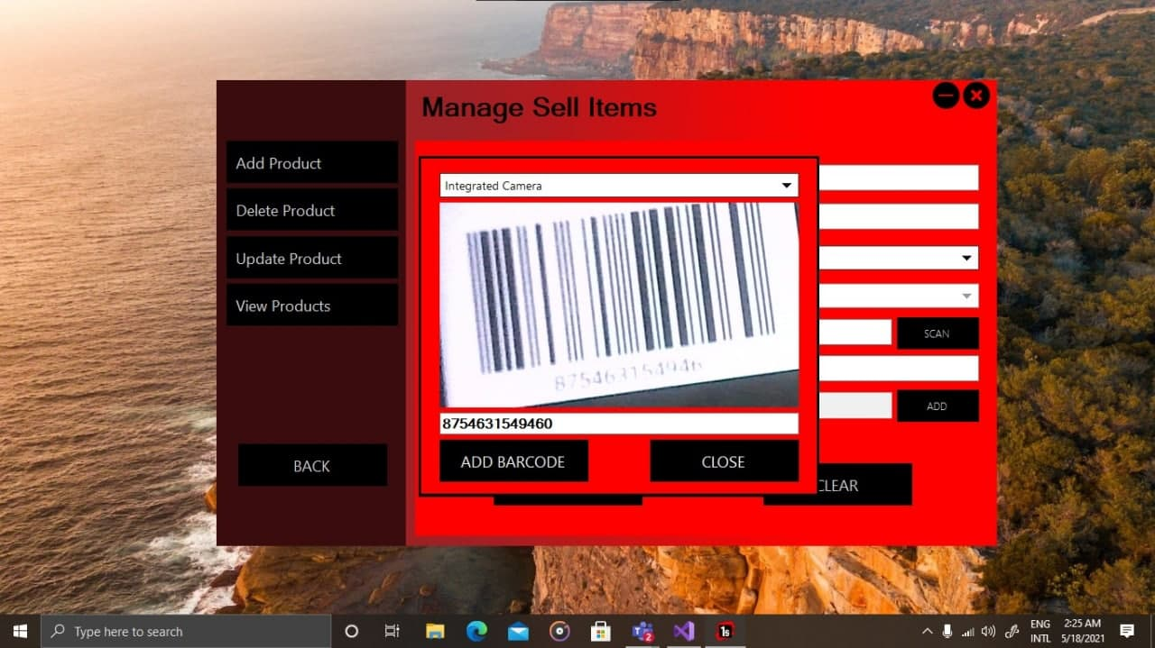
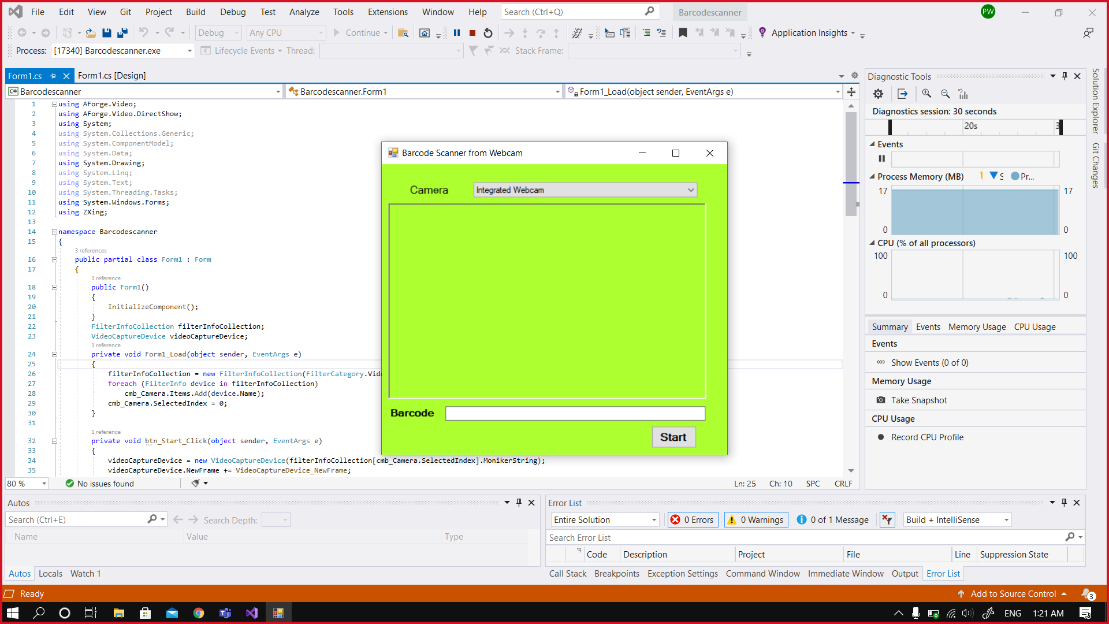

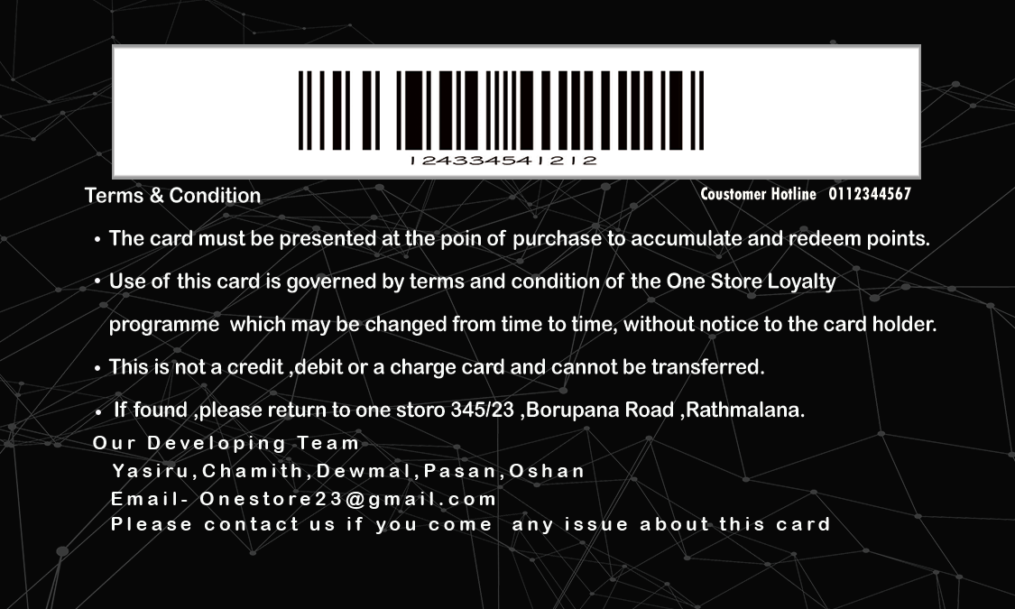
Barcode
Here we added a barcode reader and the seller can pay money with our loyalty card.

Slide 6

Price tag
we designed a price tag for the company. This tag includes the barcode which the customer can use when purchasing.

Slide 7

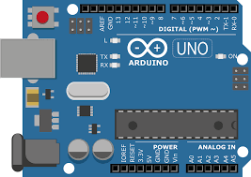


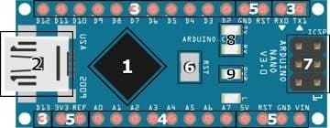
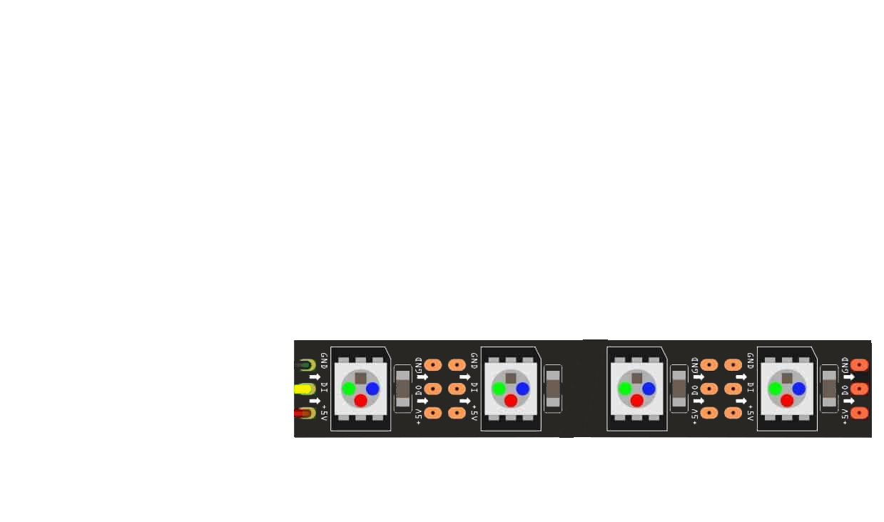
Arduino
Serial Connection
Fingerprint
5v
GND
One Store
3
6
2
Buffer
Arduino Uno board
(Photo 01)
(This photo about how fingerprint working in login form)
7
5V
Ardiuno Nano
Pixel LED
(Photo 02)
(This photo about how showroom lights control)
GND

Slide 8
database
Database
(Microsoft SQL)
Manage Sell Items
Fringerprint
Admin Home
Reports
Manage Employee
Store Social Media
Store Light Coloue&ApplicationColour
Splash Screen from
Login
Seller Home
Sell Item
Register Loyalty Card
View Item
User name & Password
Reports
Music Player

Slide 9
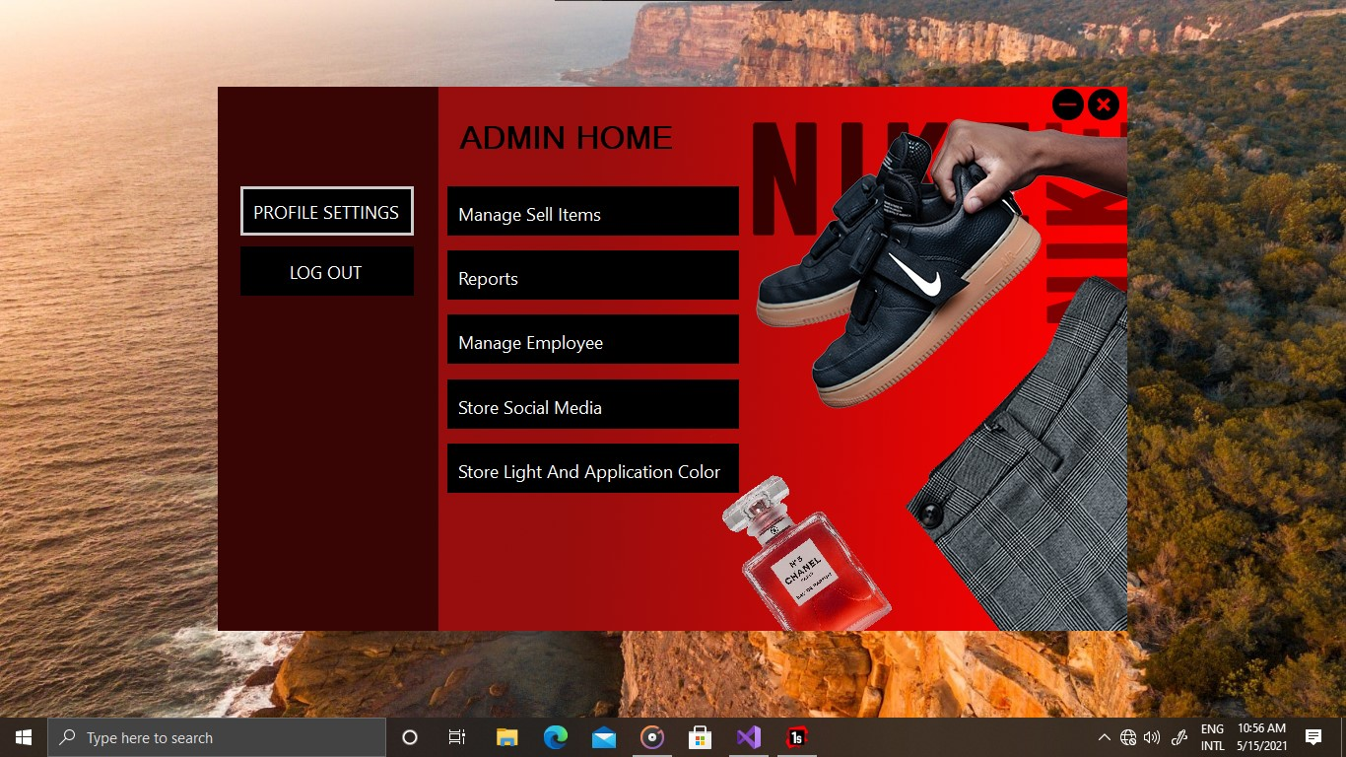
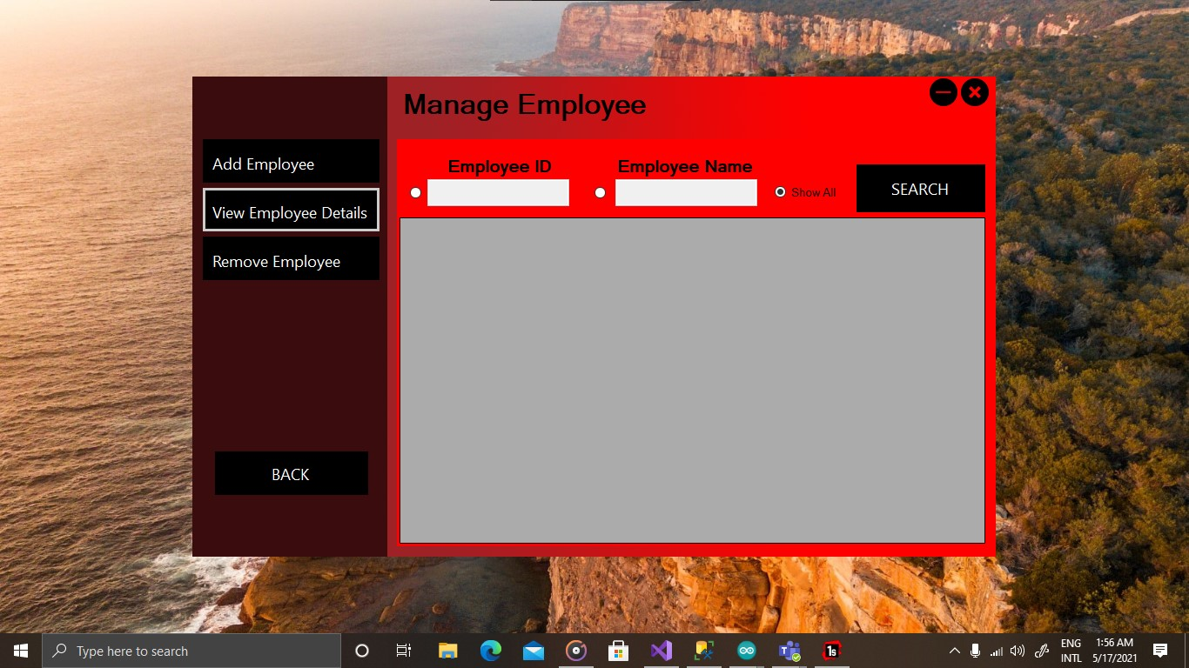
Admin home
This is our Admin Home form. He has all privileges and his logging details will store in a database. Also he can update his own login details and change his password.
Employee Home
Another thing is admin can manage their employee. He can add or remove and He can view employee data using data gridview.

Slide 10
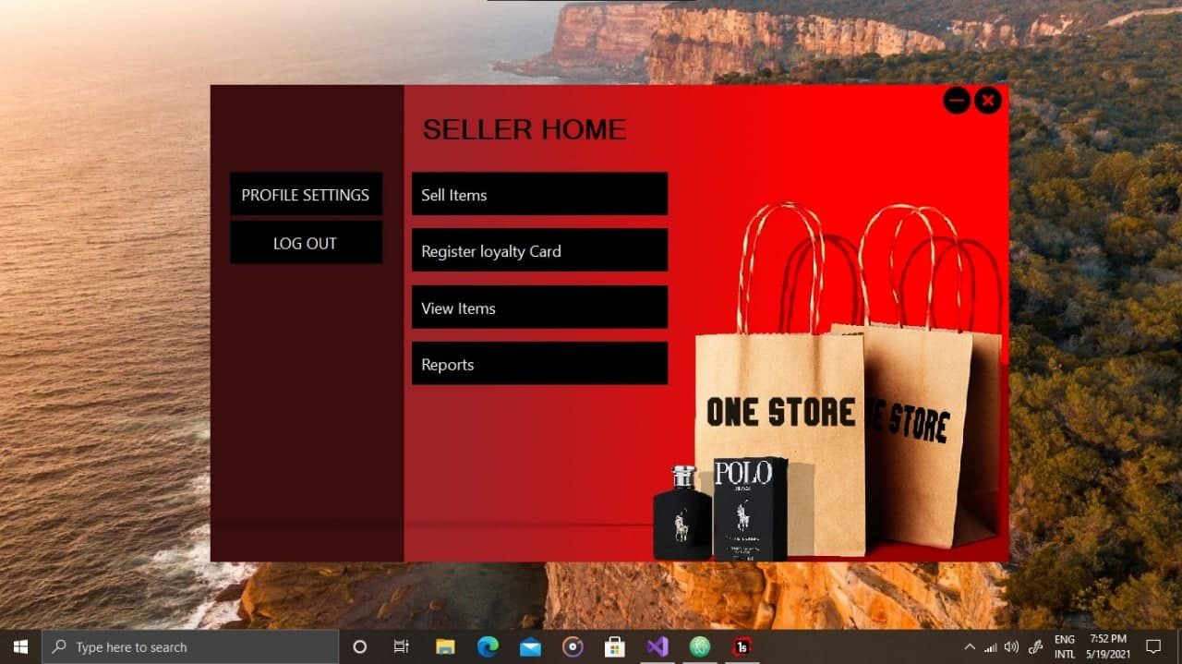
Seller home
Here is our seller home form. seller can sell items, register loyalty card, view items and report. Also he/she can view data in the database(product table only).

